Slide 1
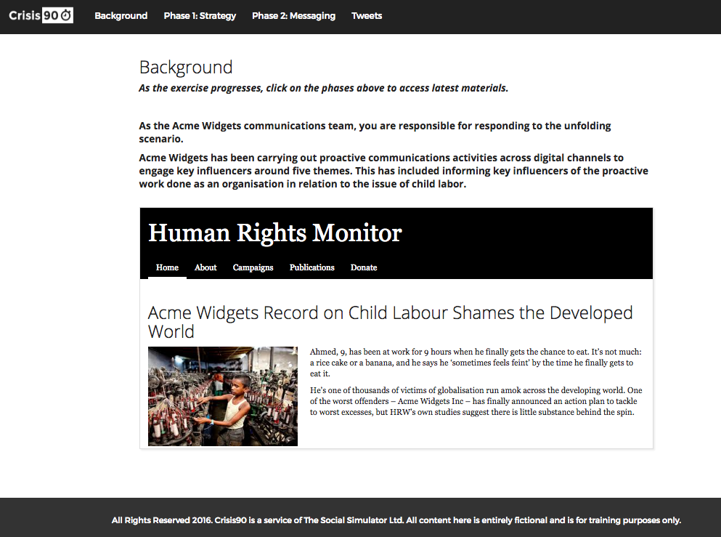
Preparing To Manage Online Issue & Crisis Communications
Crisis90 is an interactive, facilitated desktop training exercise.
It allows participants to practise responding appropriately and effectively to issues that may emerge online, in a private, secure environment.
Fostering teamwork and collaborative thinking, the session allows participants to work in small groups to complete step-by-step tasks for an unfolding online crisis communication scenario.
The session can be completed in 90 minutes.

Slide 2
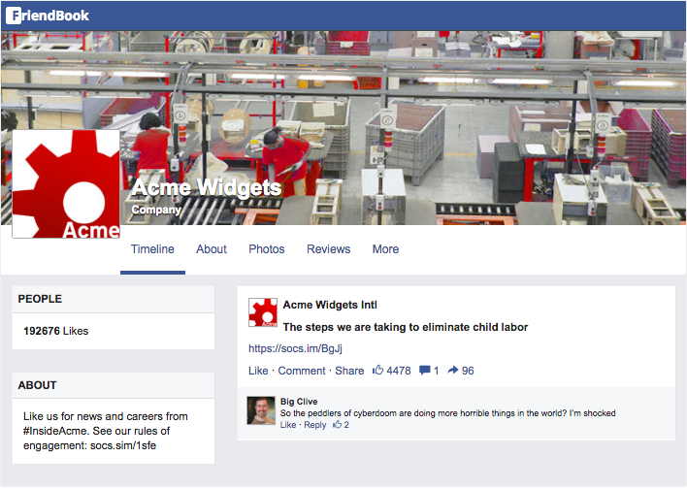
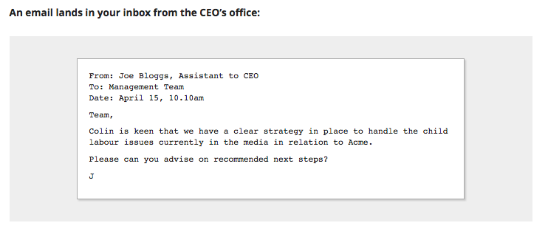
How Does It Work?
Over a series of phases, the Crisis90 platform allows for a scenario to be brought to life through a series of realistic injects, including:
Tweets
Emails
News articles and blogs
Posts in Facebook groups
Whatsapp and text messages
Audio/visual clips

Slide 3
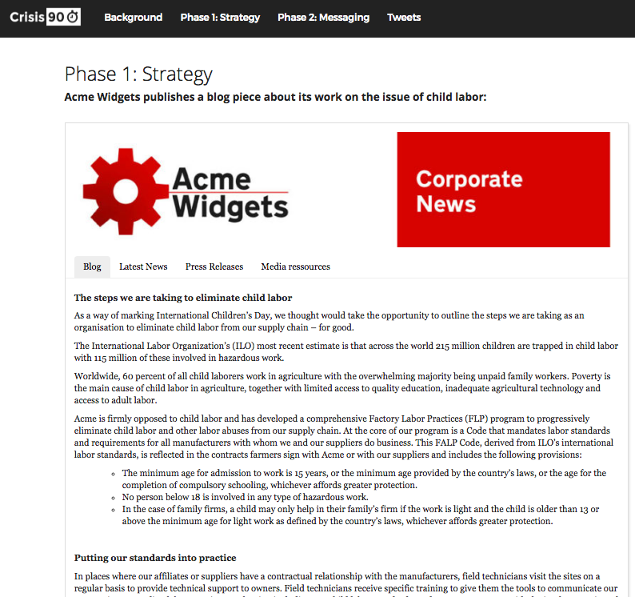
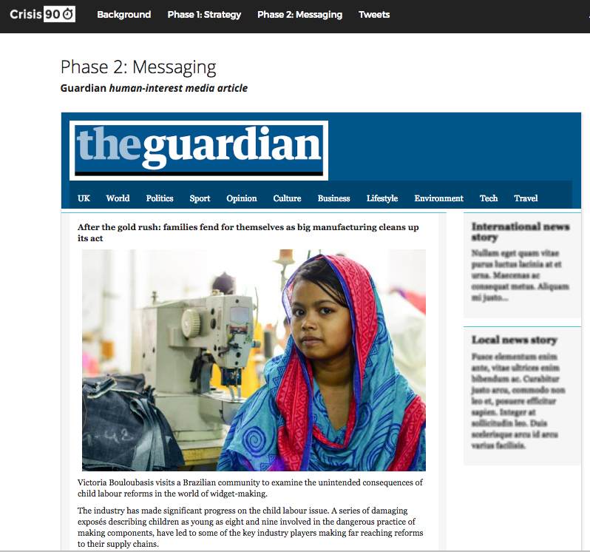
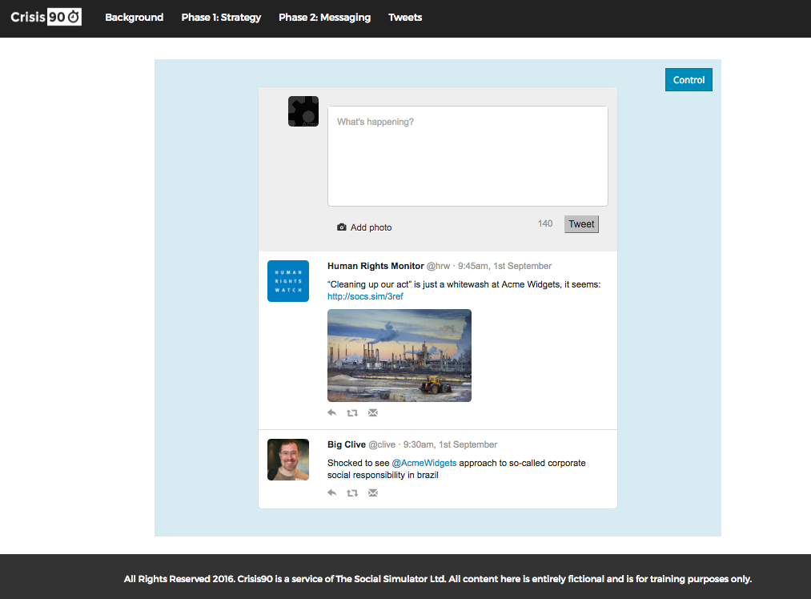
Example Phases
Three phases: Define Your Strategy, Refine Your Message, Live Twitter Rounds
The Scenario Escalates & Intensifies

Slide 4
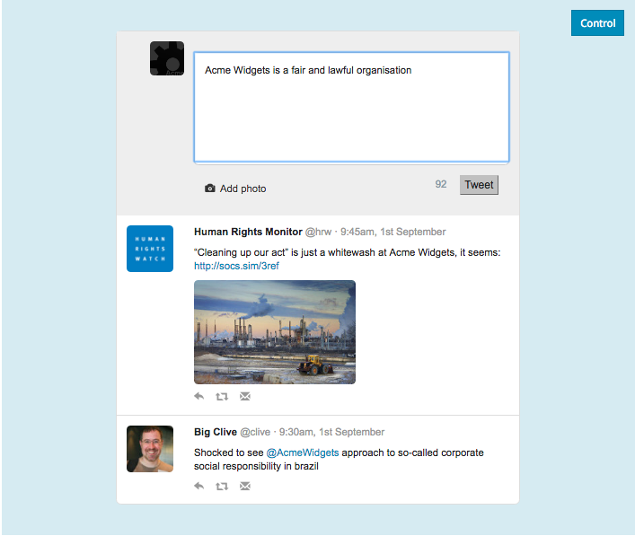
Live Twitter Engagement
Twitter-style module allows participants to experience the fast-paced pressure of responding to a crisis in real-time.
The facilitator of the Crisis90 session injects a series of tweets from a wide range of scenario characters, including journalists and customers, to challenge the participants in a live and realistic setting.

Slide 5
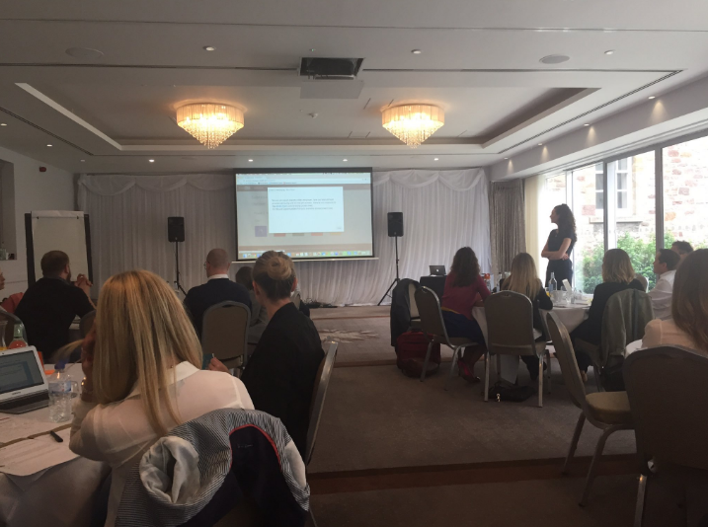
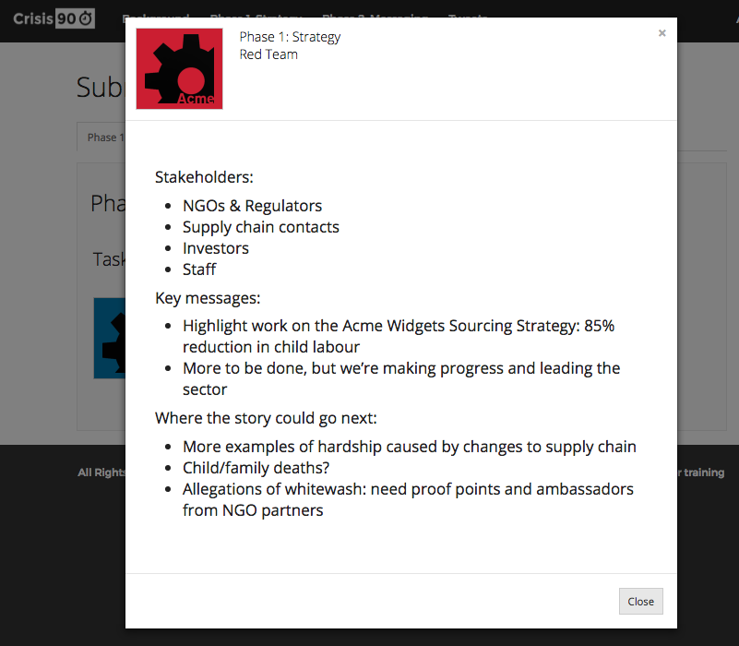
Real-time Feedback & Analysis
The facilitator reviews and analyses team submissions at the end of each phase with the group
Submissions are benchmarked against best practice
Participants are encouraged to share relevant experiences and challenge the approaches taken by other teams

